Slide 1

MooMarket
1905009,1905010,1905020,
1905021,1805017,1805066

Slide 2
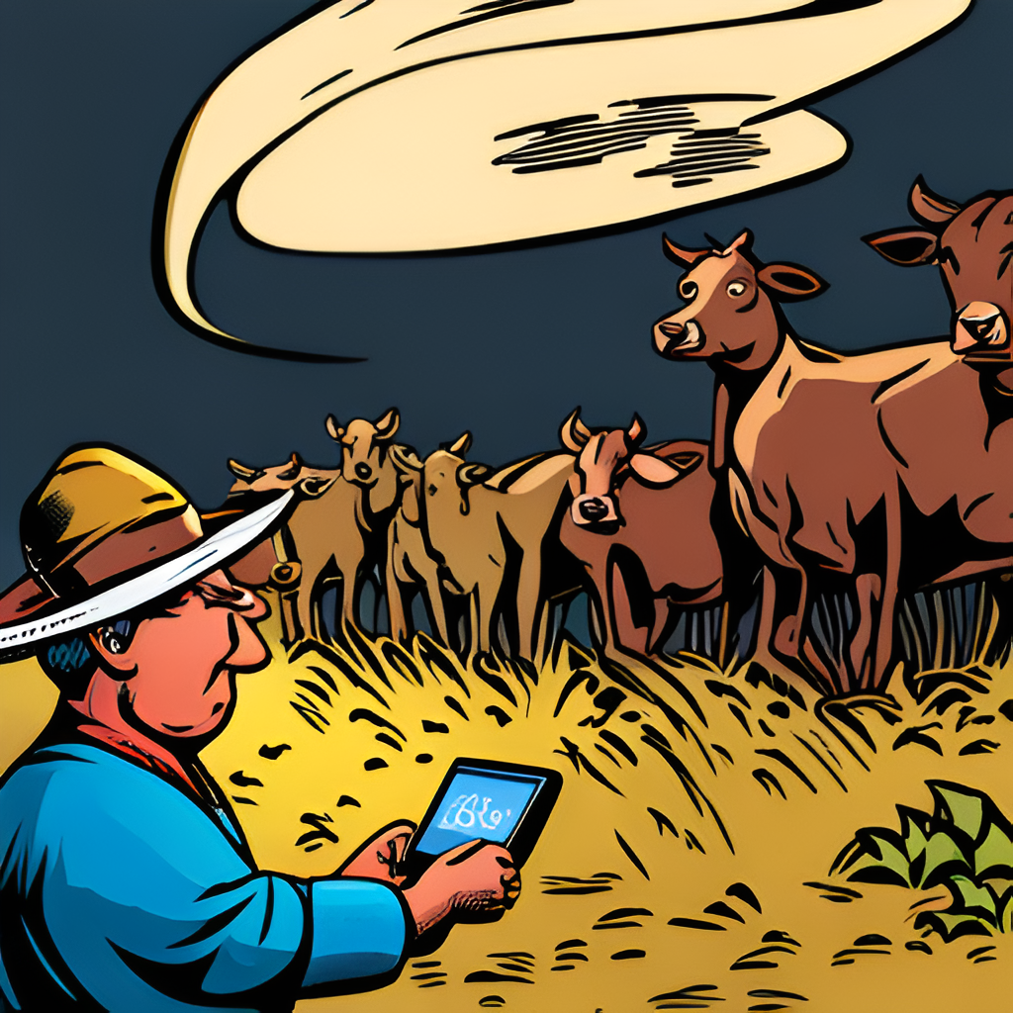
Introduction
Welcome to our presentation on the web platform for selling cattle and meat.
Any firm must have an online presence in the current digital era. This platform gives cattle and beef vendors a way to reach a larger audience and run their businesses more effectively.
Our site has an intuitive user interface that makes the purchasing and selling process easier. It is intended to speed up, simplify, and increase the security of transactions.
Buyers and sellers can communicate with one another on our platform from any location in the world.

Slide 3

Motivation
For creating the Cattle and Meat Selling web platform is to provide a better solution for sellers and buyers in the meat industry.
We believe that our platform can make a positive impact on the global meat market by providing a more efficient, transparent, and secure marketplace.
We are motivated by the potential for growth and expansion, as well as the opportunity to make a positive impact on the lives of farmers and consumers around the world.

Slide 4

Why use Web portal?
Sellers are limited to local buyers, which restricts their potential customer base.
The process of finding buyers is time-consuming and often involves middlemen, resulting in higher costs for sellers
There is no guarantee of payment or quality control, which can lead to disputes and loss of revenue.

Slide 5
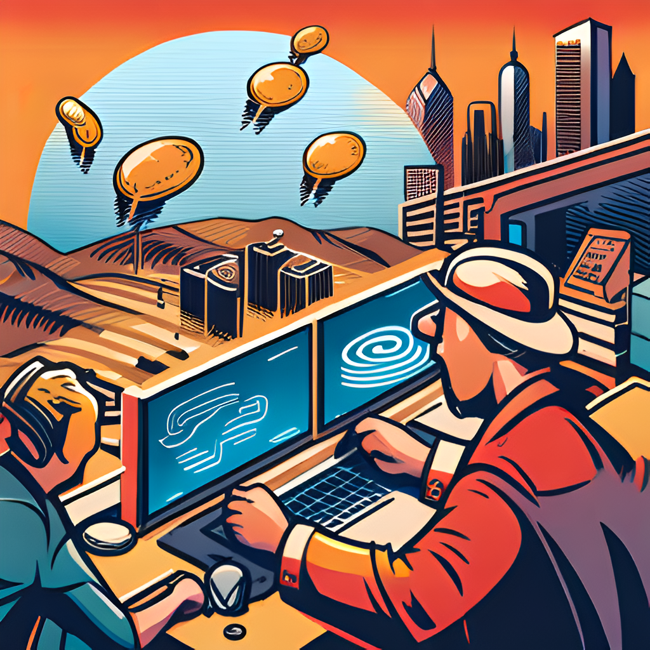
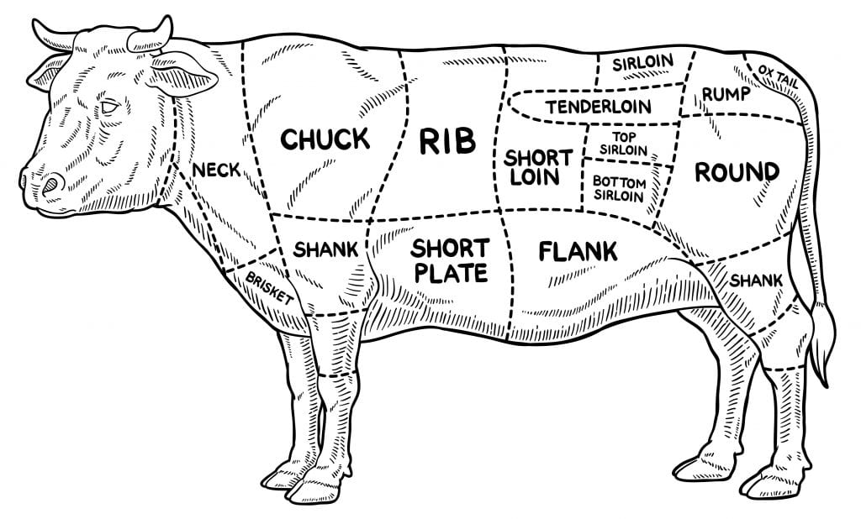
Modules

Slide 6


Features desrciptions

Slide 7

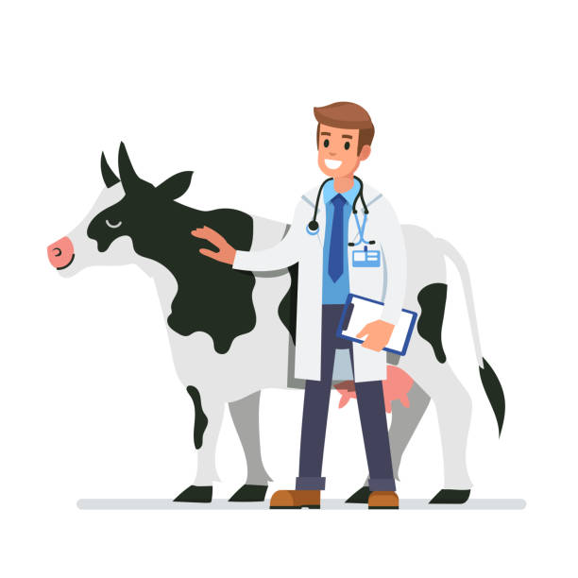

Slide 8
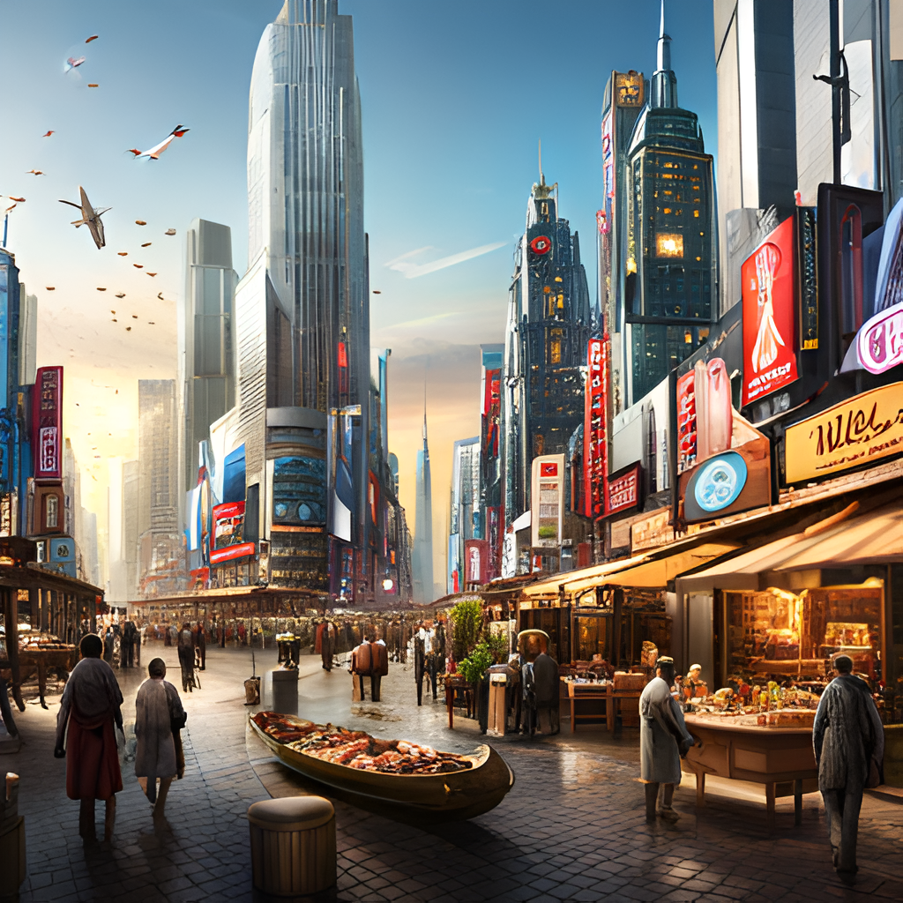
Future Opportunities
Virtual Reality (VR) Experience: Provide immersive experiences for customers. This could include virtual tours of cattle farms, meat processing facilities, and tanneries, allowing customers to gain a deeper understanding of the production process and make more informed purchasing decisions.
3D Visualizations of Tanning Process: Utilize 3D animations or visualizations to showcase the tanning process from start to finish. Customers can gain a better understanding of the intricate steps involved in transforming raw hides into finished leather products.
IoT Integration for Real-Time Tracking: Integrate IoT (Internet of Things) devices, such as RFID tags or sensors, to track the temperature, humidity, and other environmental conditions of meat products during transportation. Customers can access real-time data to ensure the freshness and quality of the products they purchase.

Slide 9

Summmary

